Slide 1

SAles Analytics
Always better

Slide 2
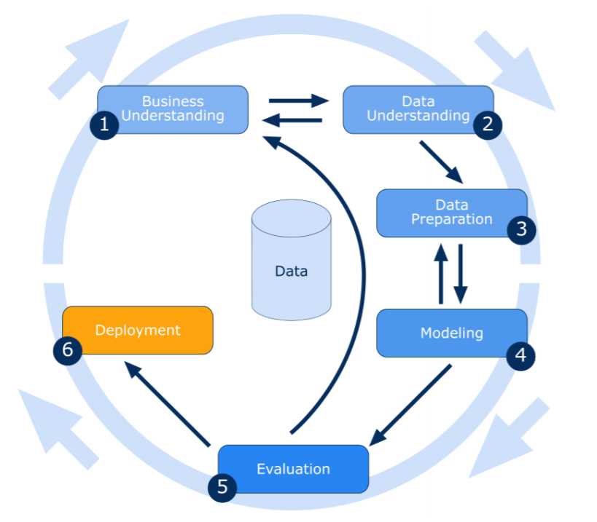
Approach/Framework
1
To understand business objectives and data mining goals to frame the problem and define success criteria
2
To explore and familiarize yourself with the data, assessing its quality and relevance for analysis
3
To Clean, preprocess, and transform the data to make it suitable for modeling.
4
To develop and test predictive or descriptive models using various algorithms and techniques
5
To assess model performance against business objectives and select the best-performing models
6
To Implement and integrate the model into the operational system for decision-making.

Slide 3
Business Understanding
As per the observation made on the Company Annual report for 2021 -22 and 2022-23, the following were some data points to be noted,
Revenue:
- 2021 to 2022: 48 million
- 2022 to 2023: 68 million
Approximately 20 million increase is observed.
Number of Employment:
- 2021 to 2022: 1866
- 2022 to 2023: 1596
Change: The number of employees slightly decreased, which may have been a strategic decision.
There were so many observations, among which I am trying to correlate these two data points to infer some area of improvement or potential pain points by bringing visibility and learning patterns in customer behaviour region-wise, product category and month wise
Expenditure increase: While revenue increased significantly, so did the company’s expenditure, especially in categories like staff cost and other expenditure. It’s essential to manage and control expenses to ensure sustained profitability
Employee headcount: Monitoring and managing the number of employees is important to control labor costs and maintain efficiency
Goal: To predict customer profiles based on region, month, and product category for the year 2022, using a machine learning model trained on data from the year 2021. This analysis will help determine staffing requirements for the year 2022.

Slide 4
Data Understanding - Descriptive
categories
Cust ID
description
Categorical
region
month
year
units
Sales_cost
Staff_qty
Numerical
Per_staff
Staff_cost
Cost per unit

Slide 5
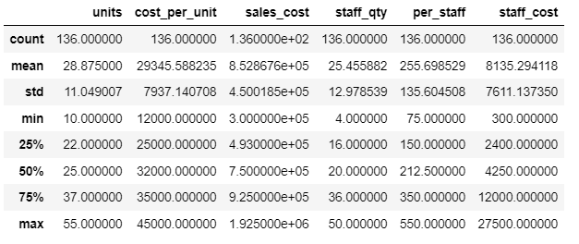
Data Understanding - Descriptive
Product categories
Reciprocating compressors
Rotary screw compressors
Oil free compressors
Centrifugal compressors
High-pressure compressors
Portable compressors
Low pressure compressors
Gas compressors
Compressed air system
Customized solutions
Region
India
USA
Europe
Middle East
Southeast Asia
Africa
Australia
South America
China
The highlights show, there are 55 maximum units while the average is around 40, we could try to observe those who are asking for more units and try to strategize.
Similarly,
The average cost per unit is 36k around while the max is 45k, followed by that staff quantity and cost seems to fluctuate a lot compared to the major data distribution.
Note: We can see there are 10 product categories that are in sales in 9 regions.

Slide 6
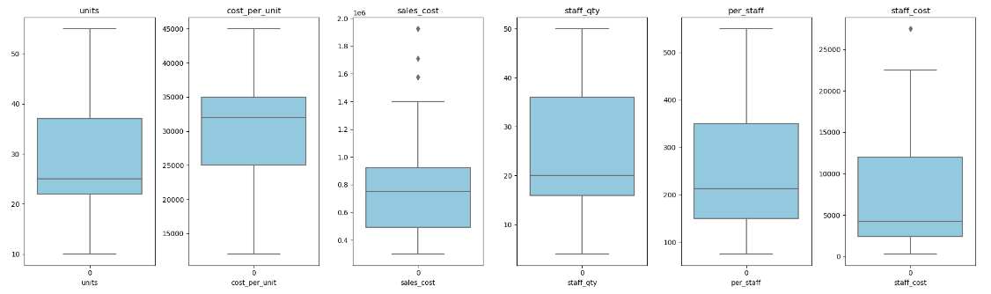
Data Understanding - Diagnostic
The highlights show that there are places where we have extremely profitable sales and also in some places where we have extreme staff costs.

Slide 7
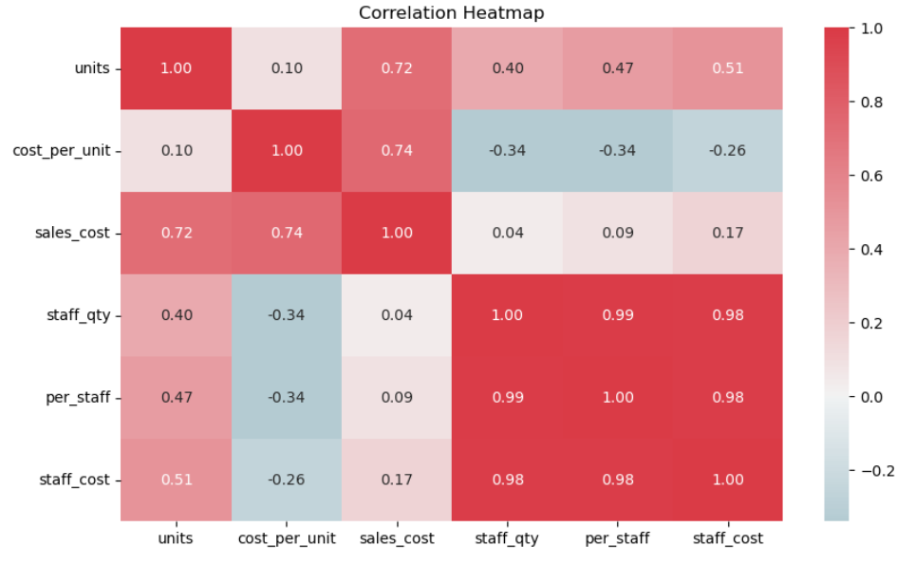
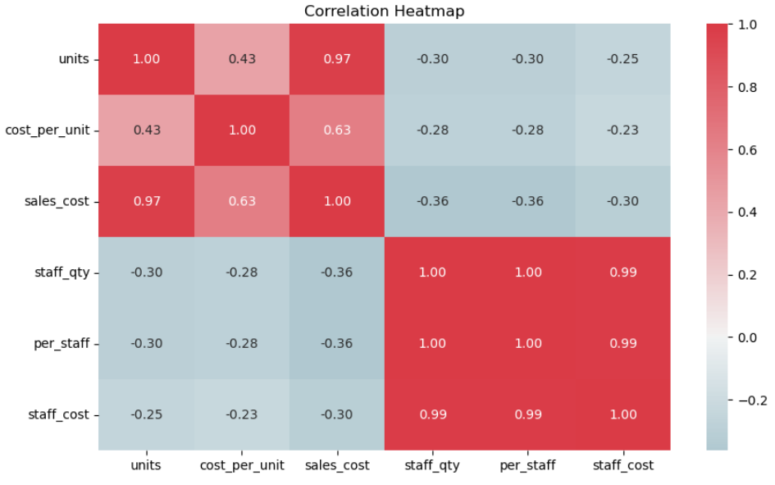
Data Understanding - Diagnostic
2021
2022
The unit usage increase resulted in staff quantity, staff cost increase in 2021 whereas in 2022 we made staff reduction with the increase of demand strategically.

Slide 8
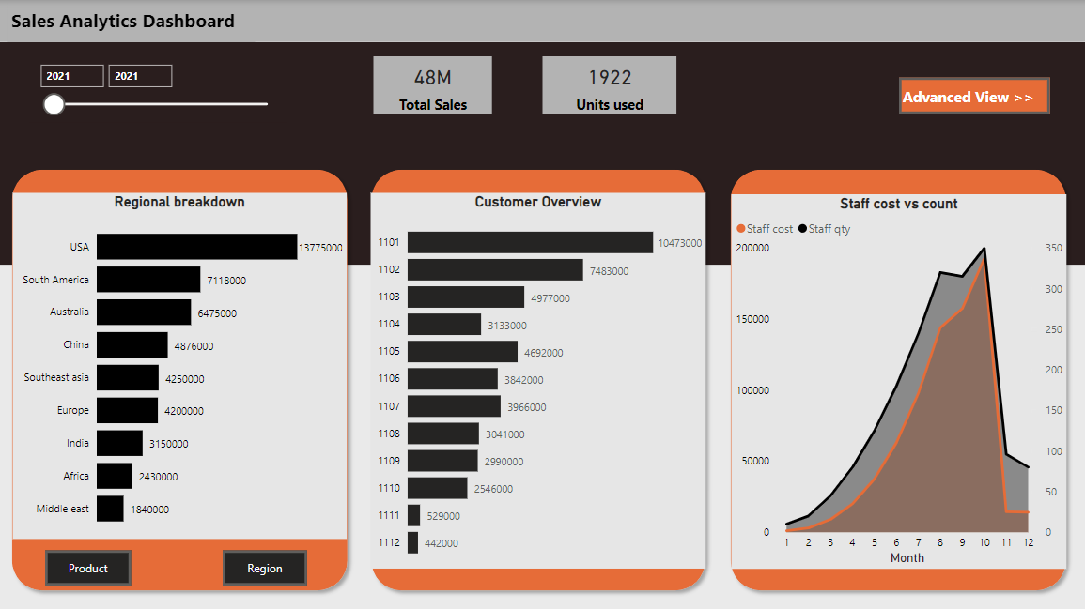
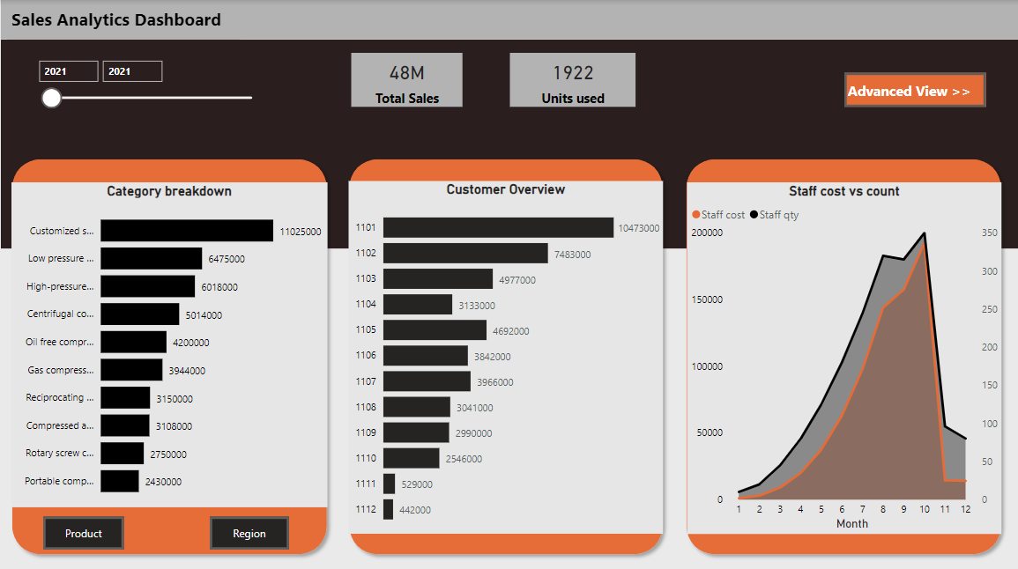
Data Preparation – 2021 Annual report
The data prepared for 2021 shows,
Top three products,
Customized Solutions
Low-pressure compressors
High-pressure compressors
Top three regions,
USA
South America
Australia
Top three customers IDs,
1101
1102
1103
Staff analysis,
Looks like we are gradually increasing the staff count and cost. The demand for the workforce is created more in the second half of the year.
Total Sales: 48Million
Units used : 1922

Slide 9
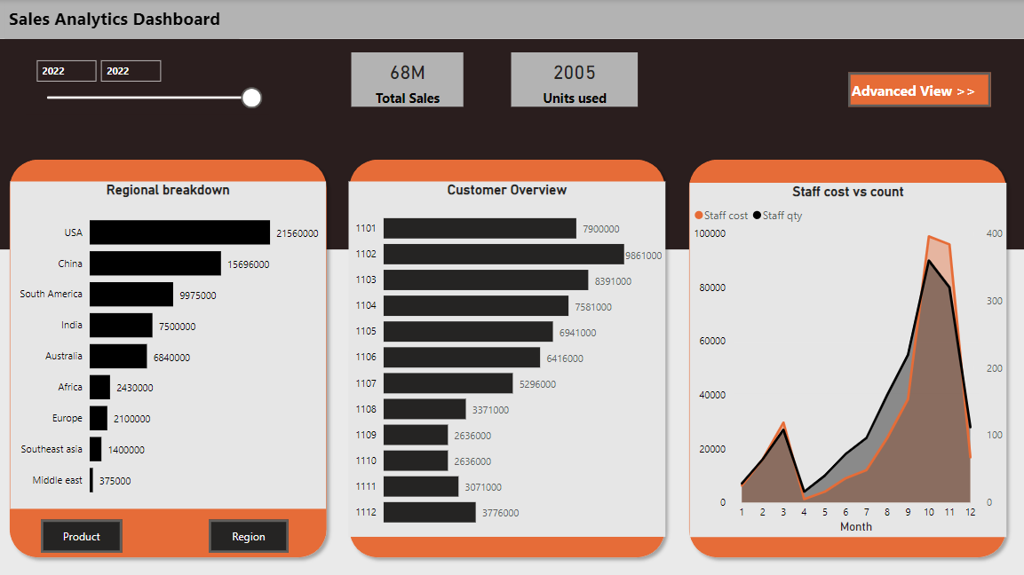
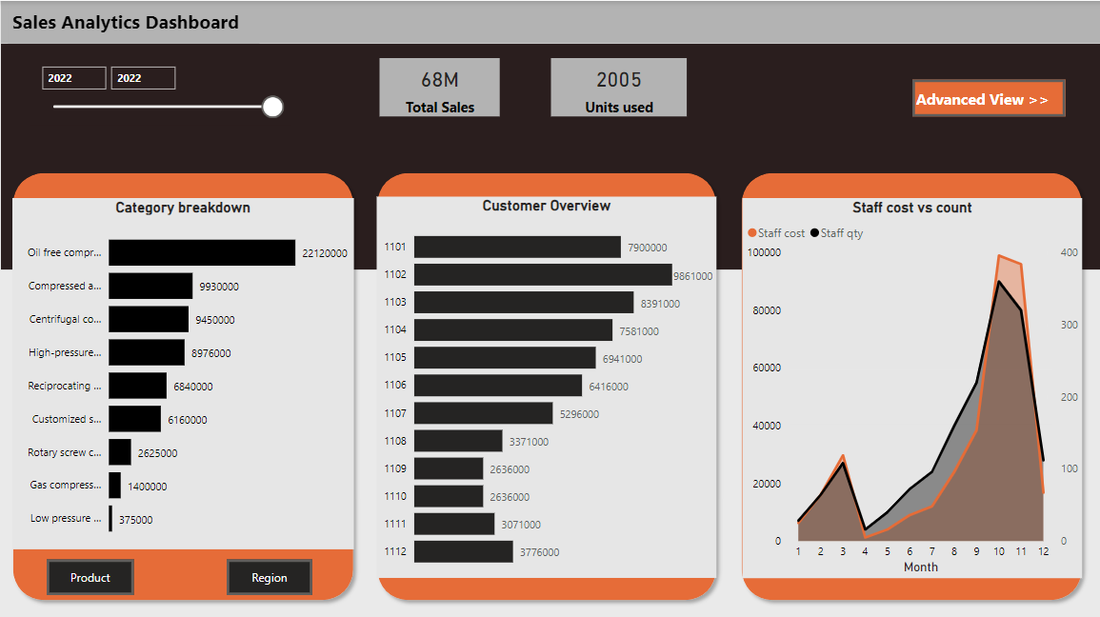
Data Preparation – 2022 Annual Report
The data prepared for 2022 shows,
Top three products,
Oil-free compressors
Compressed air system
Centrifugal compressors
Top three regions,
USA
China
South America
Top three customer IDs,
1102
1103
1101
Staff analysis,
Looks like we have been a bit proactive here in allocating staff more in the first 4 months and then the gradual increase is made as per the demand.
Total Sales: 68Million
Units used: 2005

Slide 10
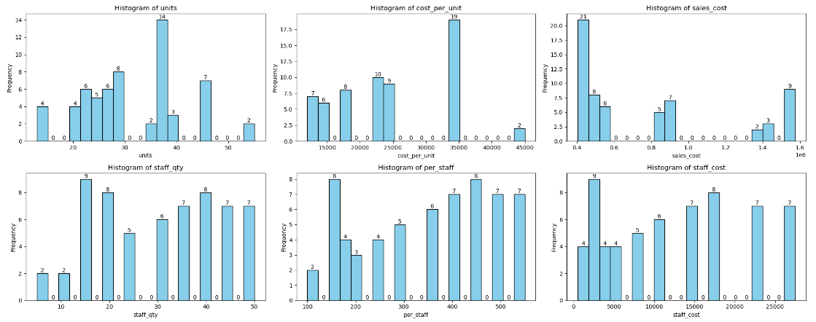
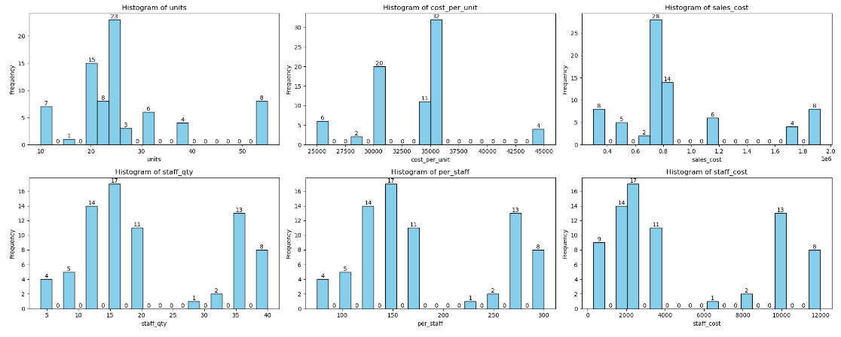
EDA - Descriptive & Diagnostic Summary
The data observation made in 2021 and 2022 gave these understandings,
Product level – The demands are different in both years
Region level – USA seems to be the top customer and was a customer in both years
Customer level – Customer ID is repeated in multiple regions and products. 1101, 1102, and 1103 are present in both years.
Staff level – There is a proactive allocation in 2022 compared to 2021 which may be a strategic move resulting in a 41.67% increase in sales
Also, the plot shows the staff quantity and staff cost were reduced but still the demands were met, which seems like a best practice (strategy applied has given results)

Slide 11
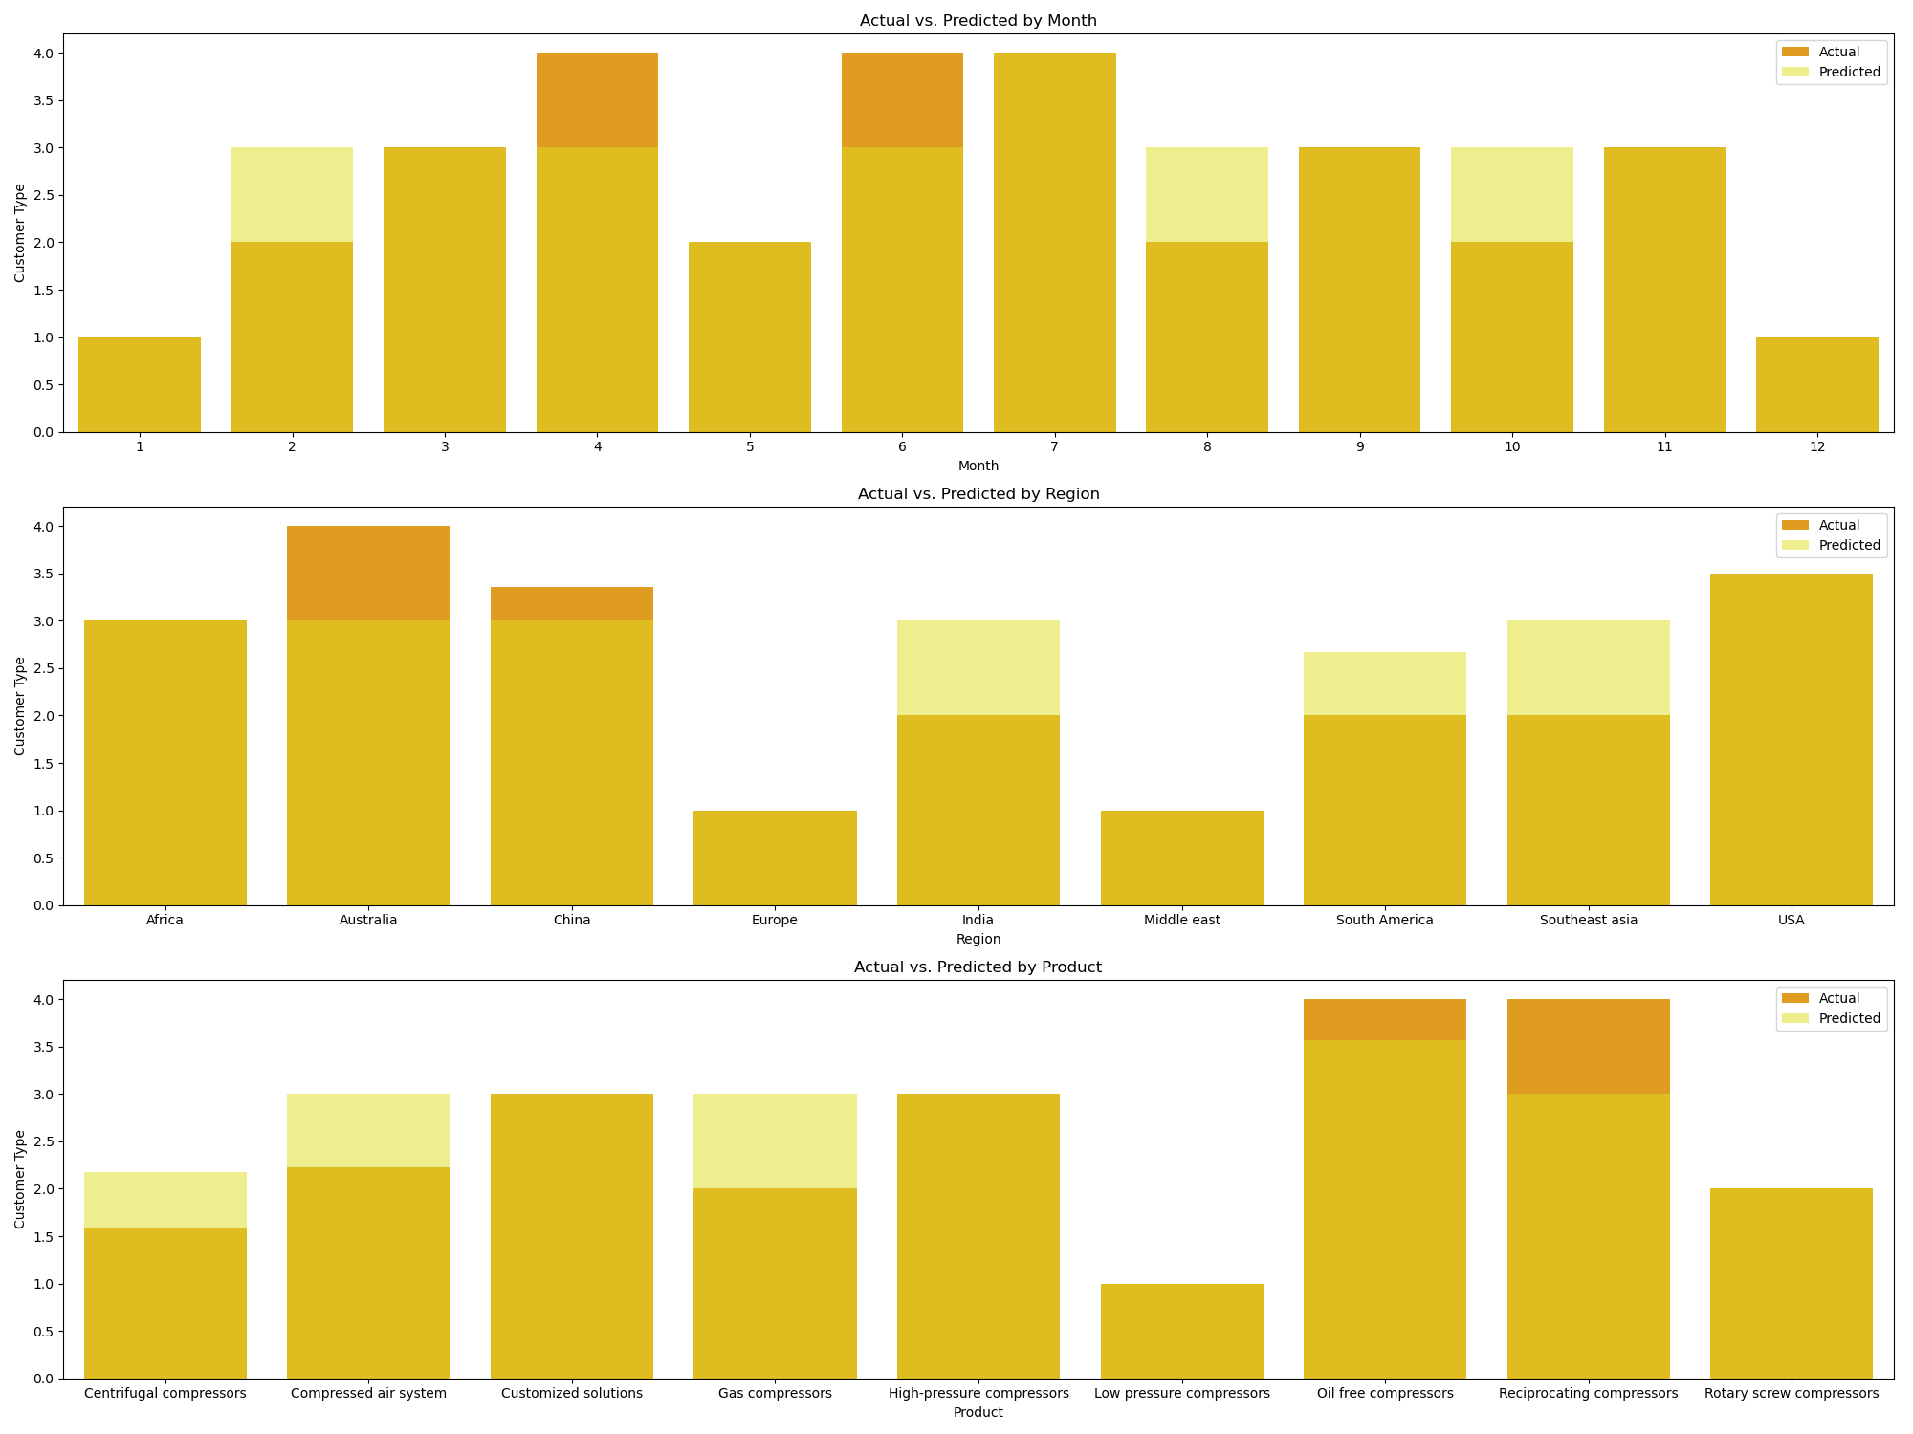
Modelling – Customer segmentation (Predictive)
The model was trained using 2021 data and predictions are made for 2022 to tell us which customer segment they may belong in 2022
The y axis is the prediction target which is,
Customer_type
1 – sales_cost ranging from 300000 to 450000
2 – sales_cost ranging from 450000 to 750000
3 – sales_cost ranging from 750000 to 1000000
4 – sales_cost ranging from 1000000 to 2000000
The plot is showing actual 2021 customer behavior pattern vs 2022 customer behavior pattern

Slide 12
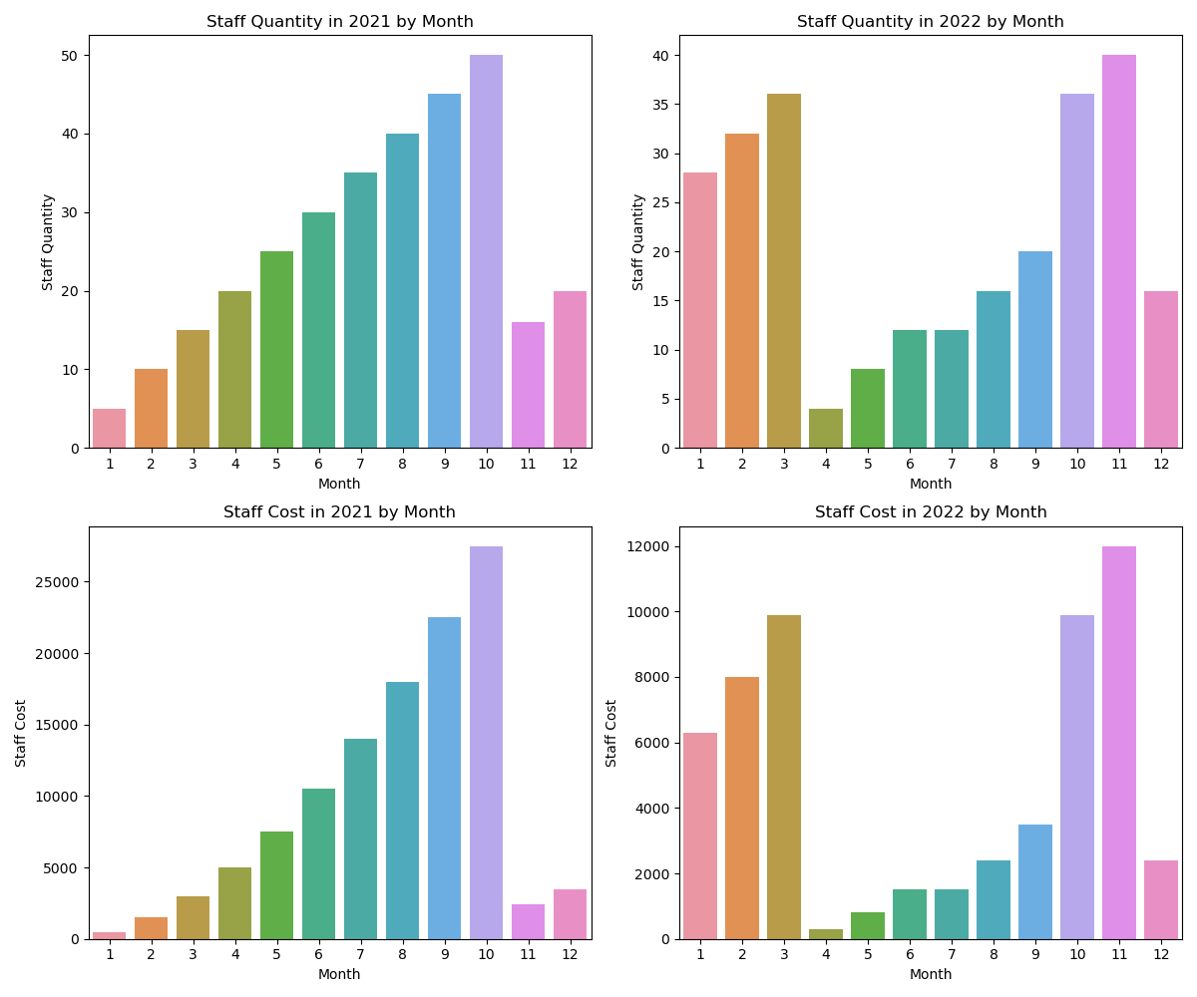
Modelling – Customer segmentation (Prescriptive)
The display is to show that, the staff_qty and staff_cost for 2021 and 2022.
Currently this is shown as available data we could even build model to show the demand of staff quantity and staff cost as well.
There is a proactive staff allocation is made in 2022 to meet the demands compared to 2021

Slide 13
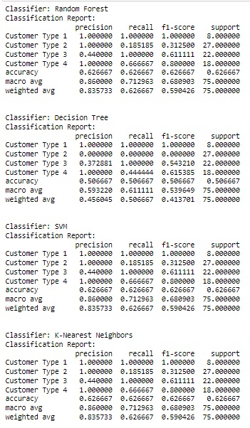
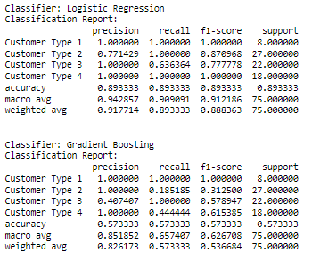
Evaluation – Customer segmentation
Precision – measures the accuracy of positive predictions made by a model. Higher precision indicates fewer false positives and a lower rate of incorrectly classifying negative samples as positive.
Recall – measures a model's ability to identify all positive instances in a dataset correctly. Higher recall indicates a lower rate of missing positive samples.
F1 – score – The F1 score is a harmonic mean of precision and recall, offering a balance between these two metrics. A higher F1 score indicates a better trade-off between precision and recall.
Overall best model accuracy is 89.8%

Slide 14
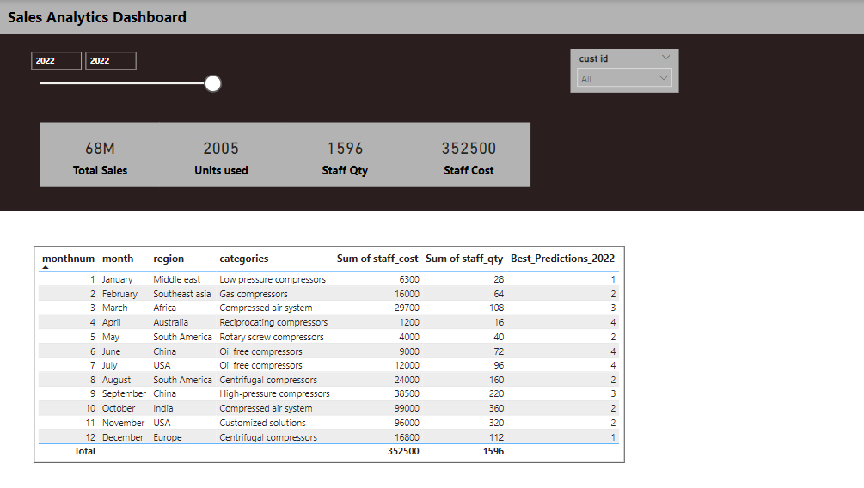
Evaluation – Customer segmentation
The best algorithm evaluated is utilized here to predict the customer profile for 2022 data and able to display the result while we could refer to this profile to meet the staff demand and cost.

